Slide 1
Pt 365 2024 updated

Slide 2
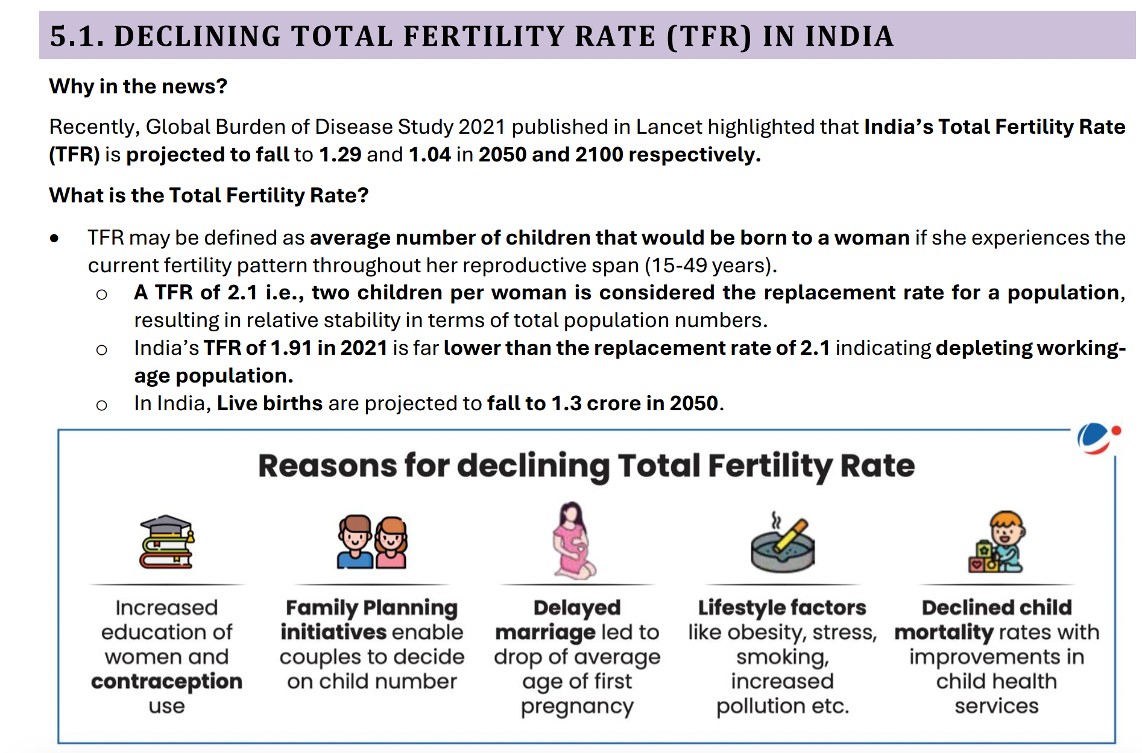

Slide 3
Some more factors:
Urbanisation: Urbanization often leads to smaller family sizes due to factors such as higher living costs,
limited space, and increased access to family planning services.
Changing Socio-cultural Norms: Shifts in socio-cultural norms, including greater acceptance of family planning and
smaller families, can influence individuals' reproductive choices.
Economic Factors: Economic factors such as rising living costs, increased participation of women in the workforce,
and the desire for better quality of life can lead to smaller family sizes.
Greater empowerment of women through education, employment opportunities, and awareness campaigns can lead to
delayed marriage and childbirth, thus contributing to lower fertility rates
Government initiatives promoting family planning and reproductive health, such as awareness campaigns, subsidies
for contraceptives, and incentives for small families, can influence fertility rates.
Improvements in healthcare infrastructure, including maternal and child healthcare services, can reduce infant mortality
rates, which, in turn, may lead to smaller family sizes as parents have fewer children in response to increased survival rates.

Slide 4
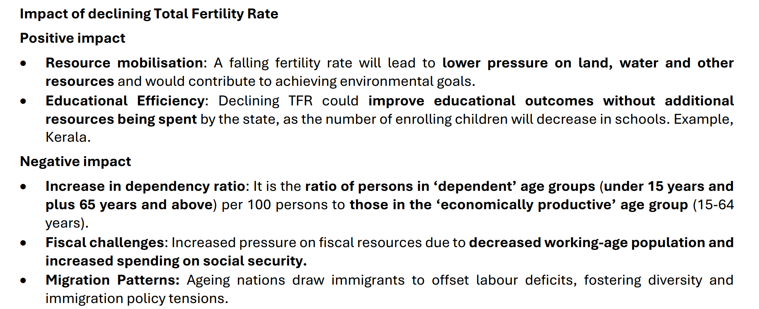

Slide 5
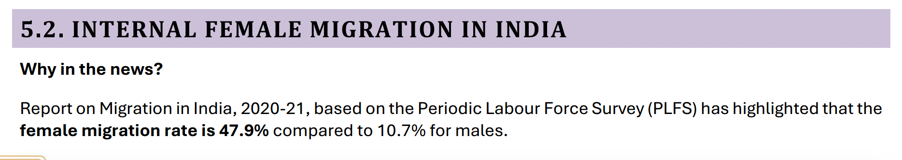

Slide 6
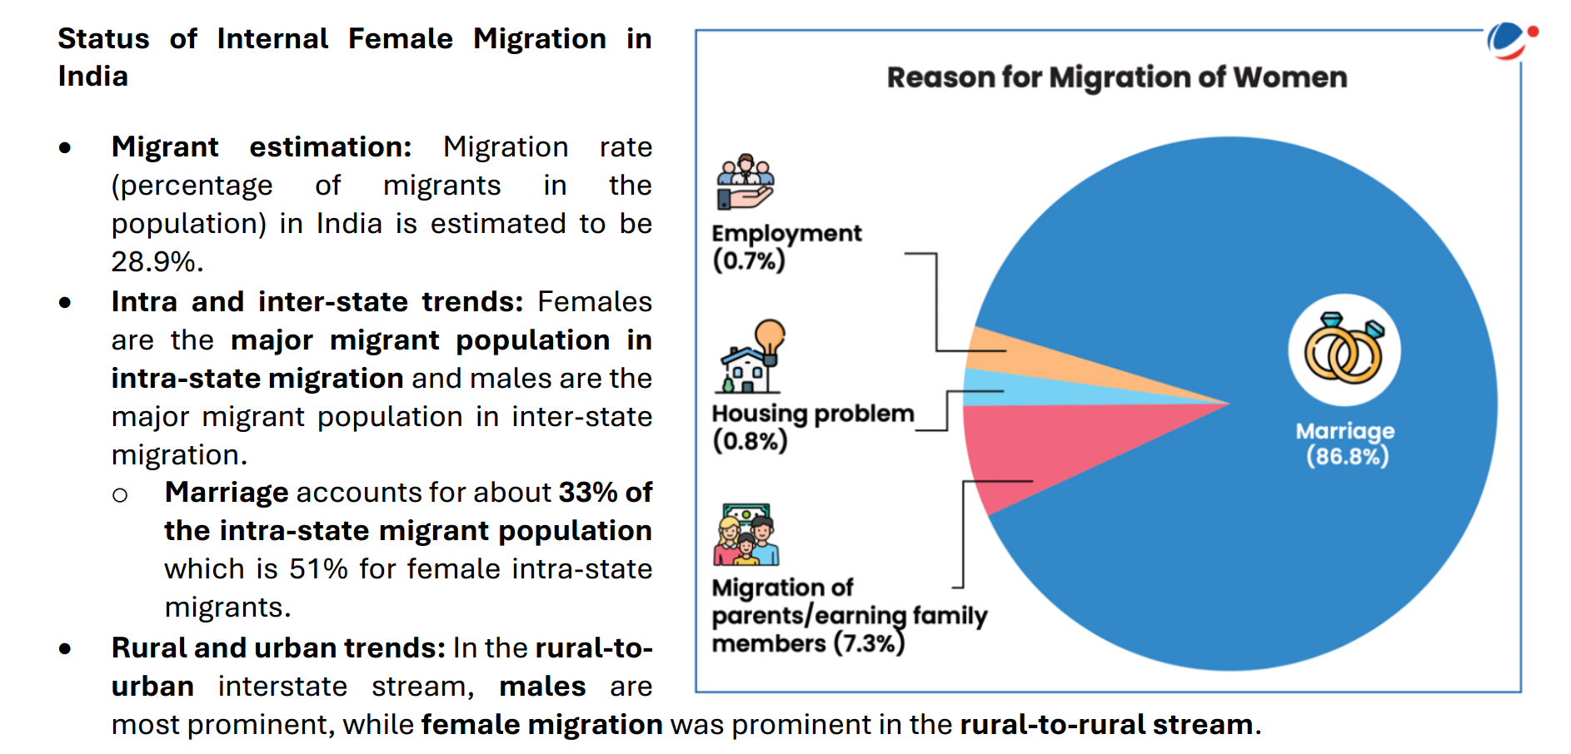

Slide 7
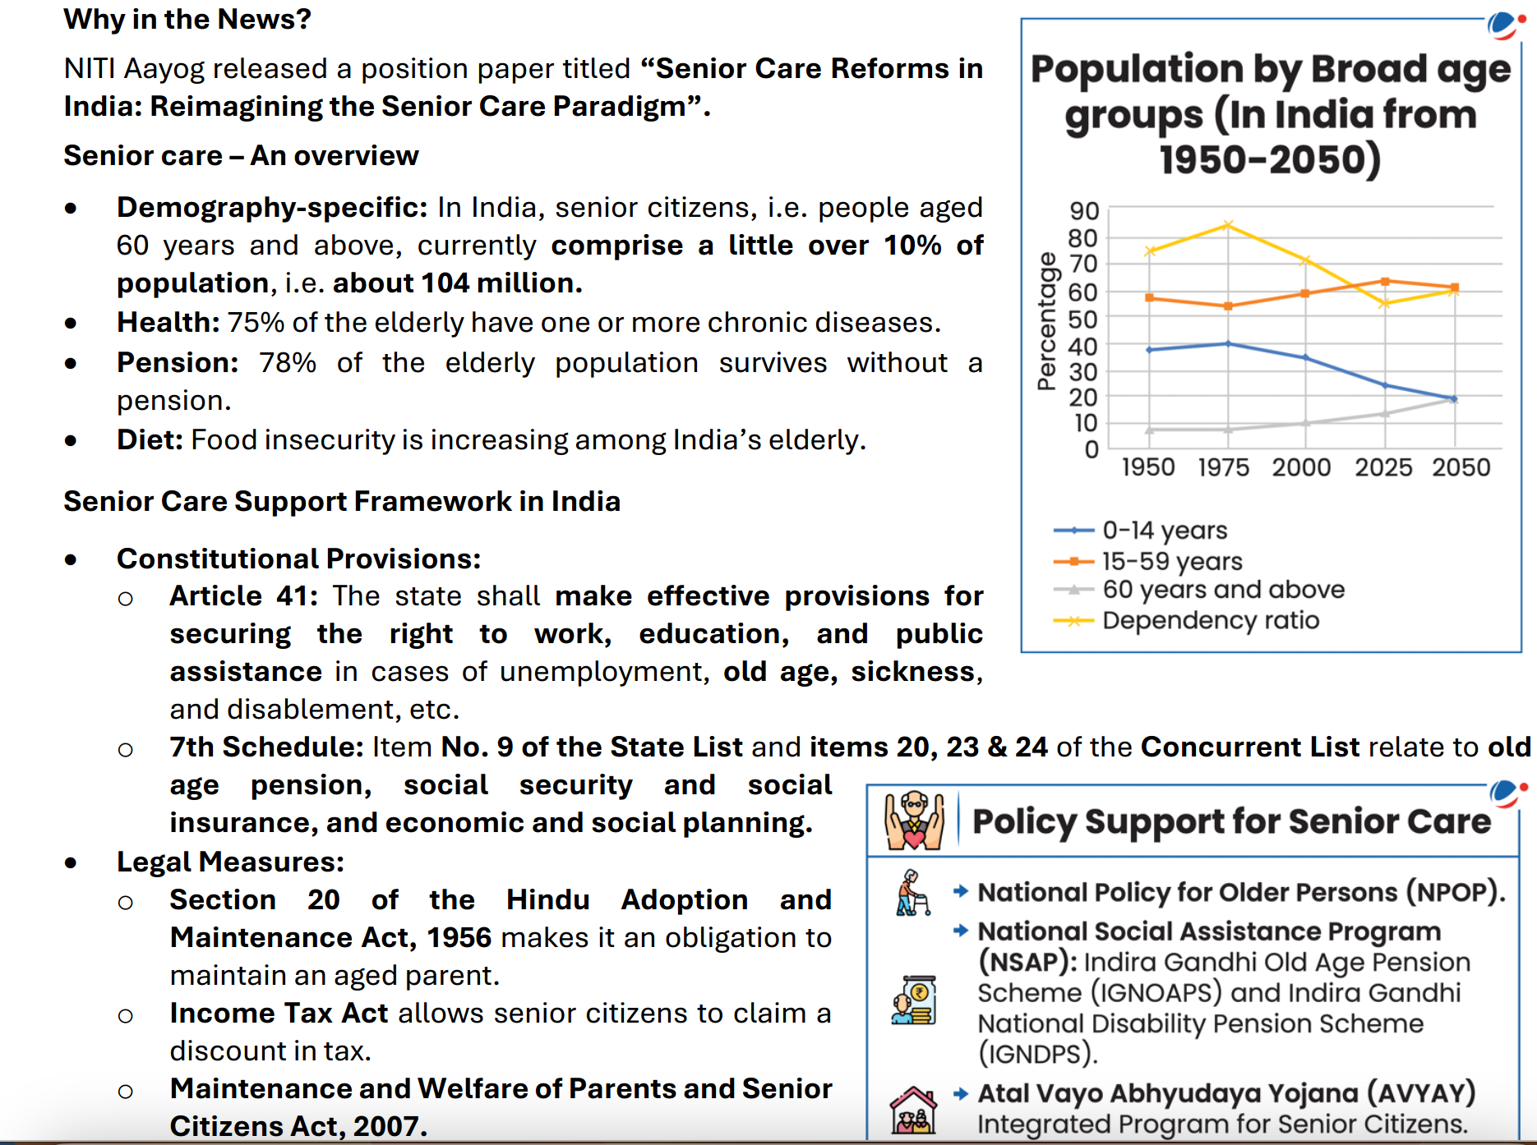

Slide 8
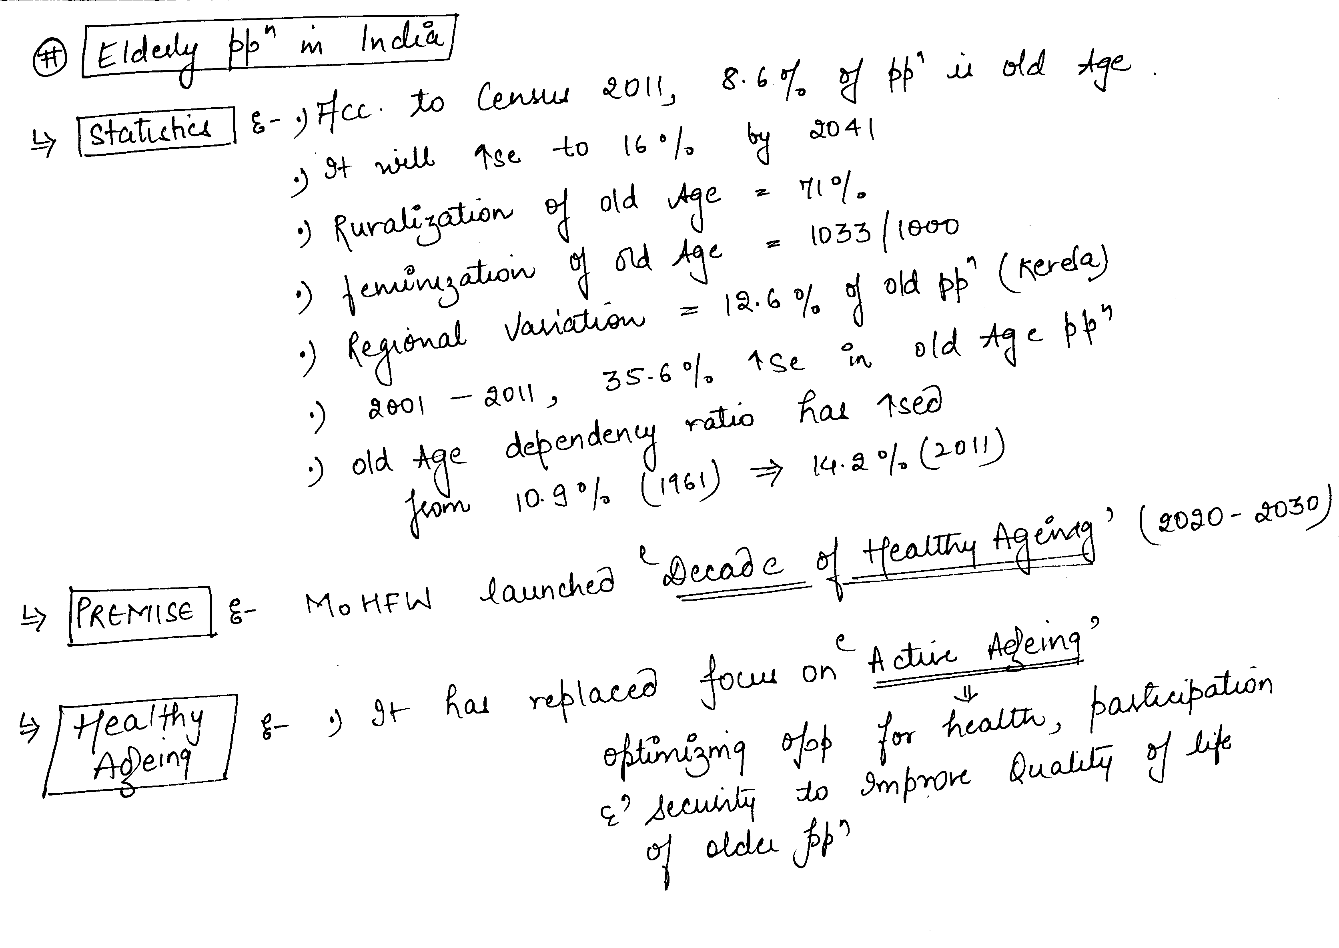

Slide 9
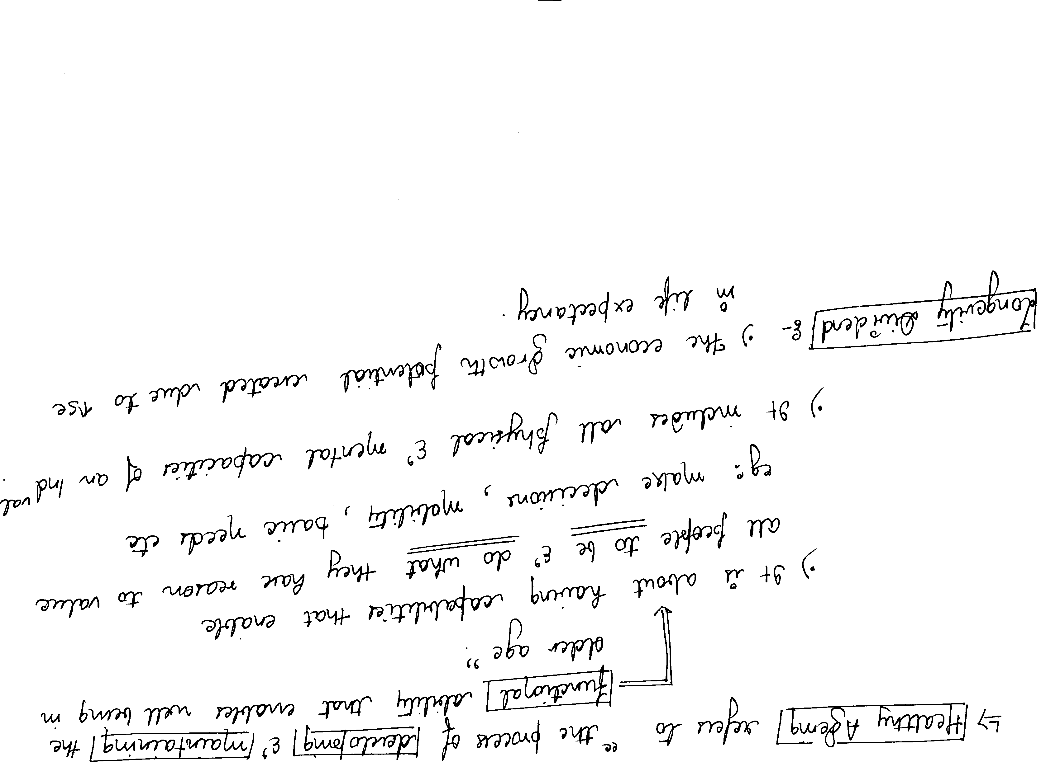

Slide 10
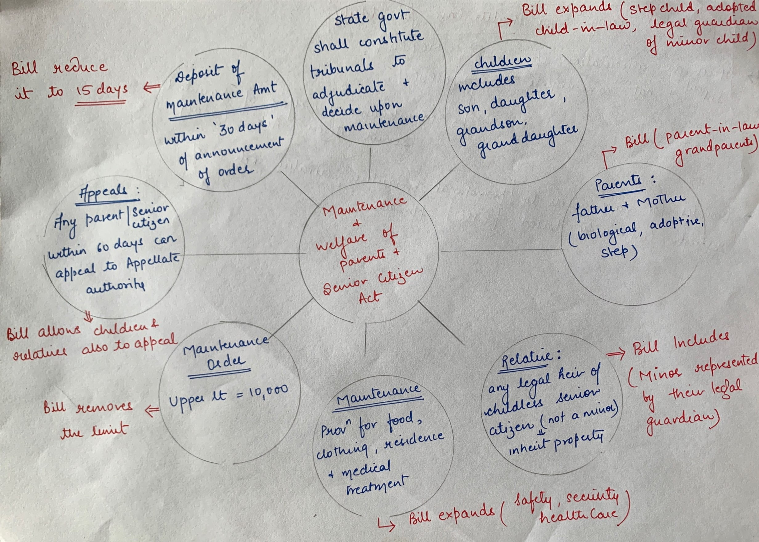

Slide 11
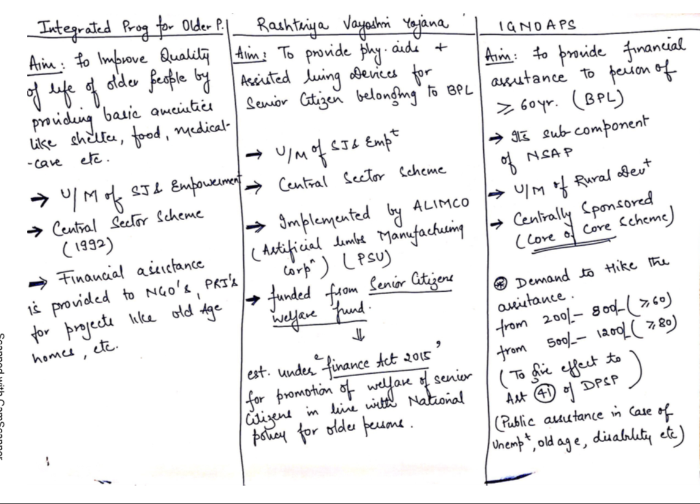

Slide 12
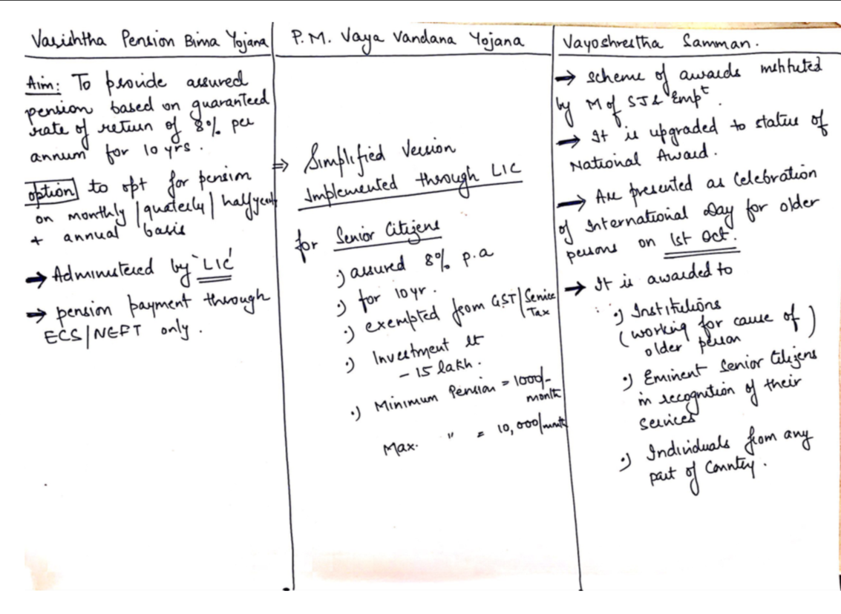

Slide 13
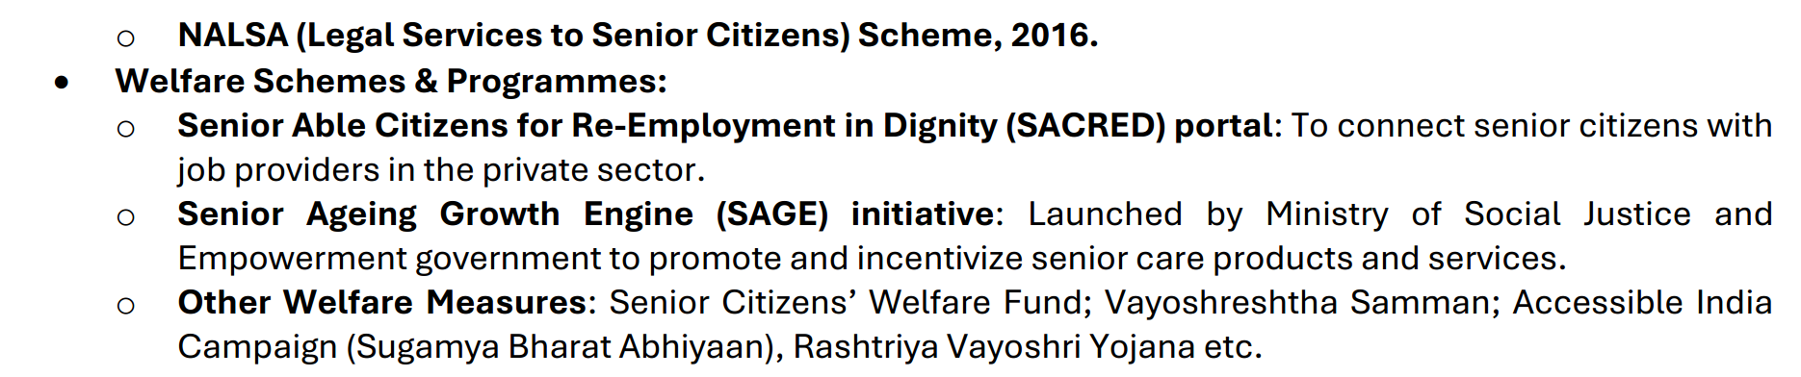

Slide 14
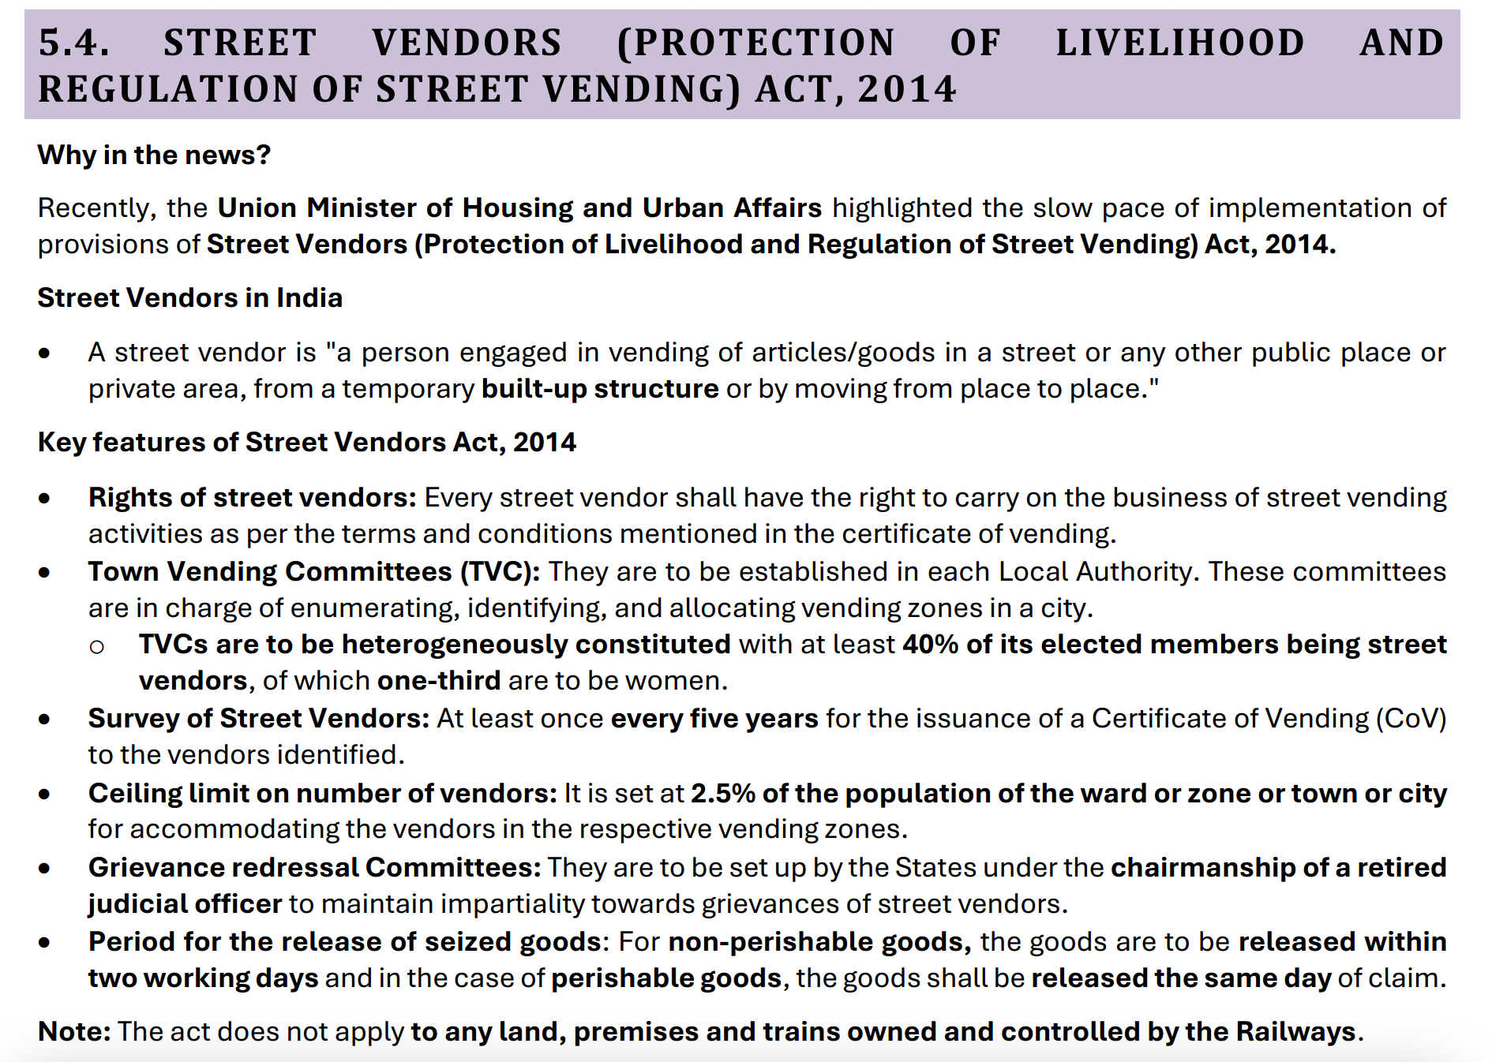

Slide 15
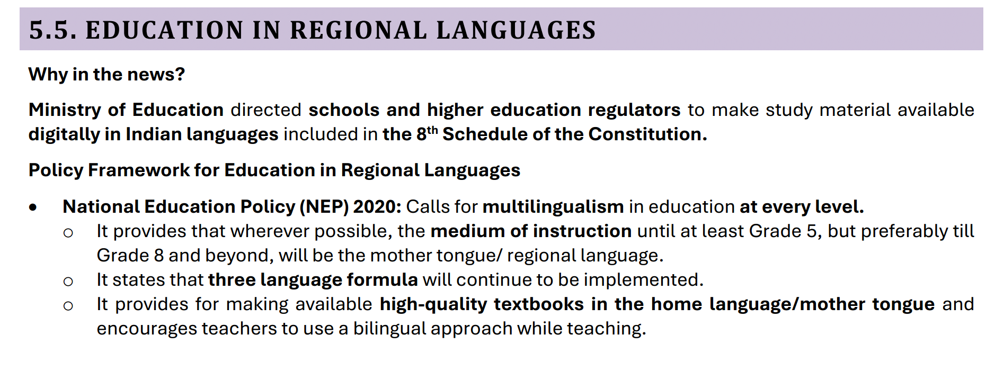

Slide 16
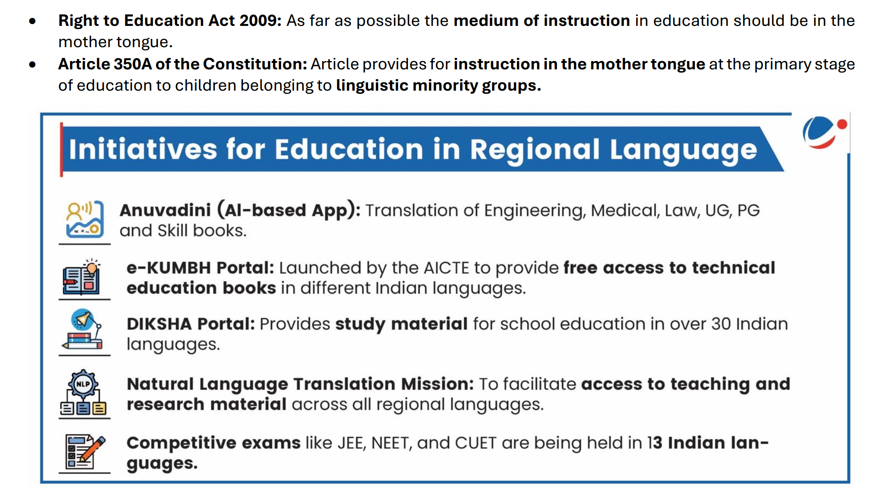

Slide 17
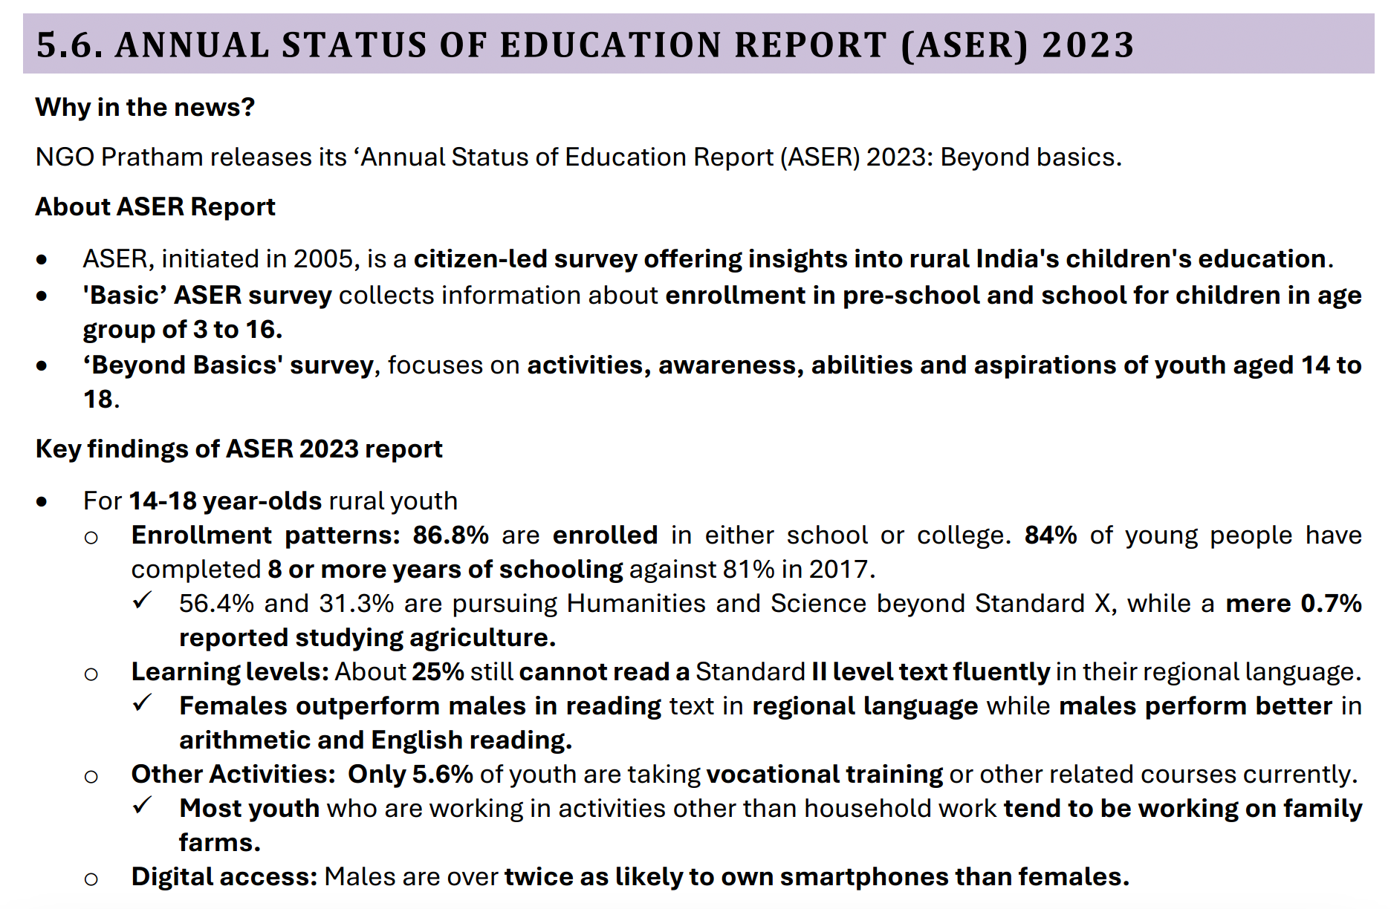

Slide 18
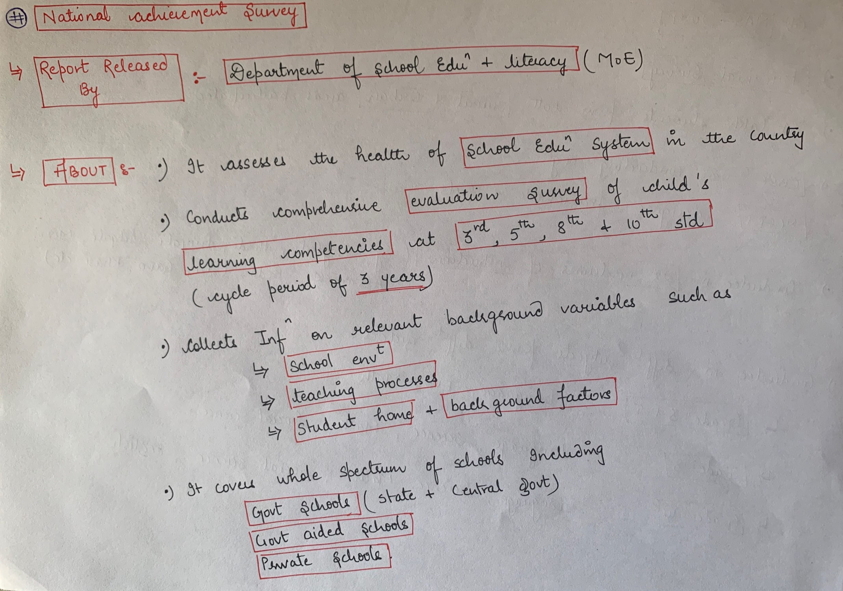

Slide 19
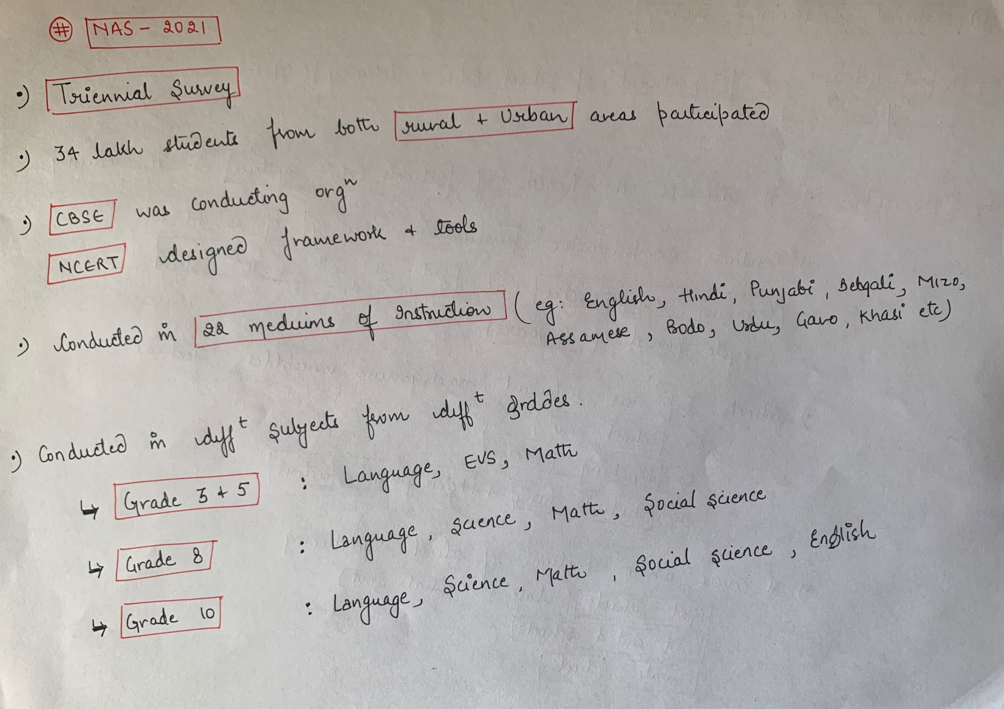

Slide 20
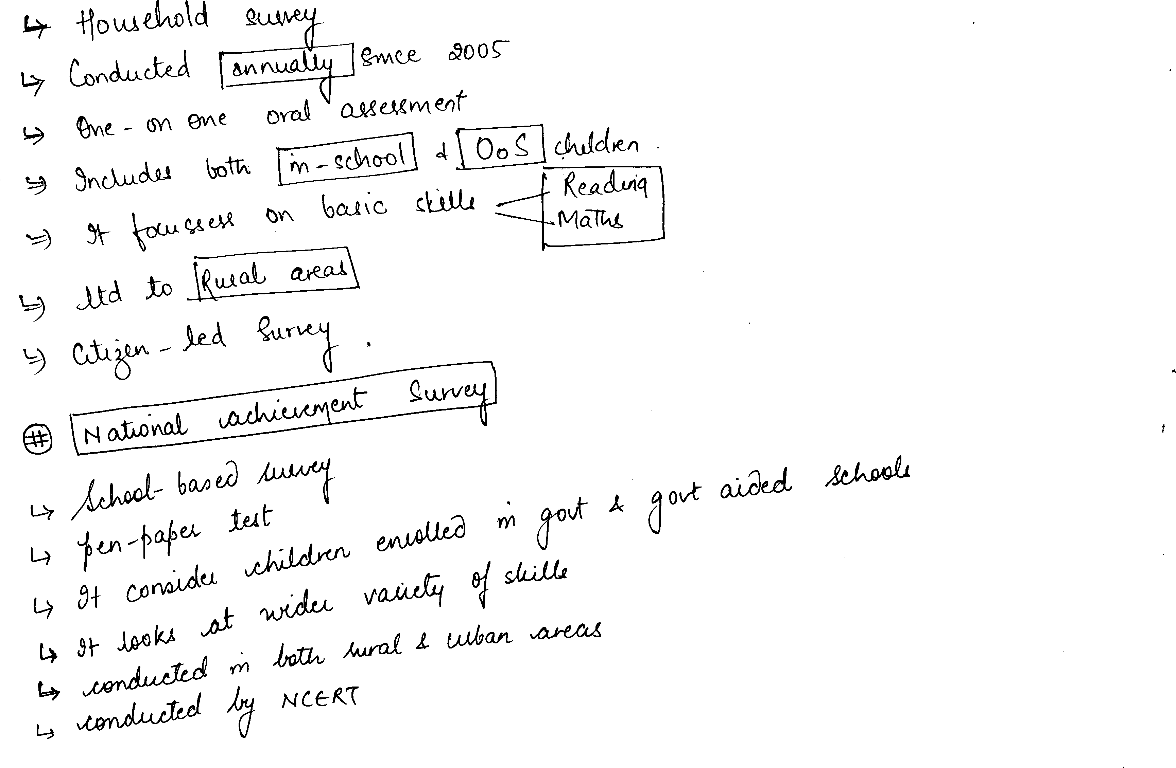

Slide 21
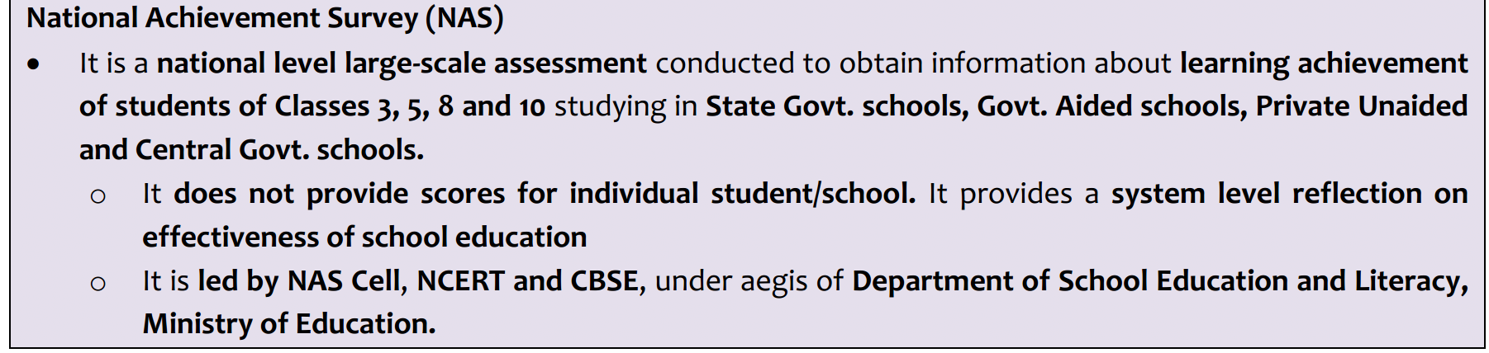

Slide 22
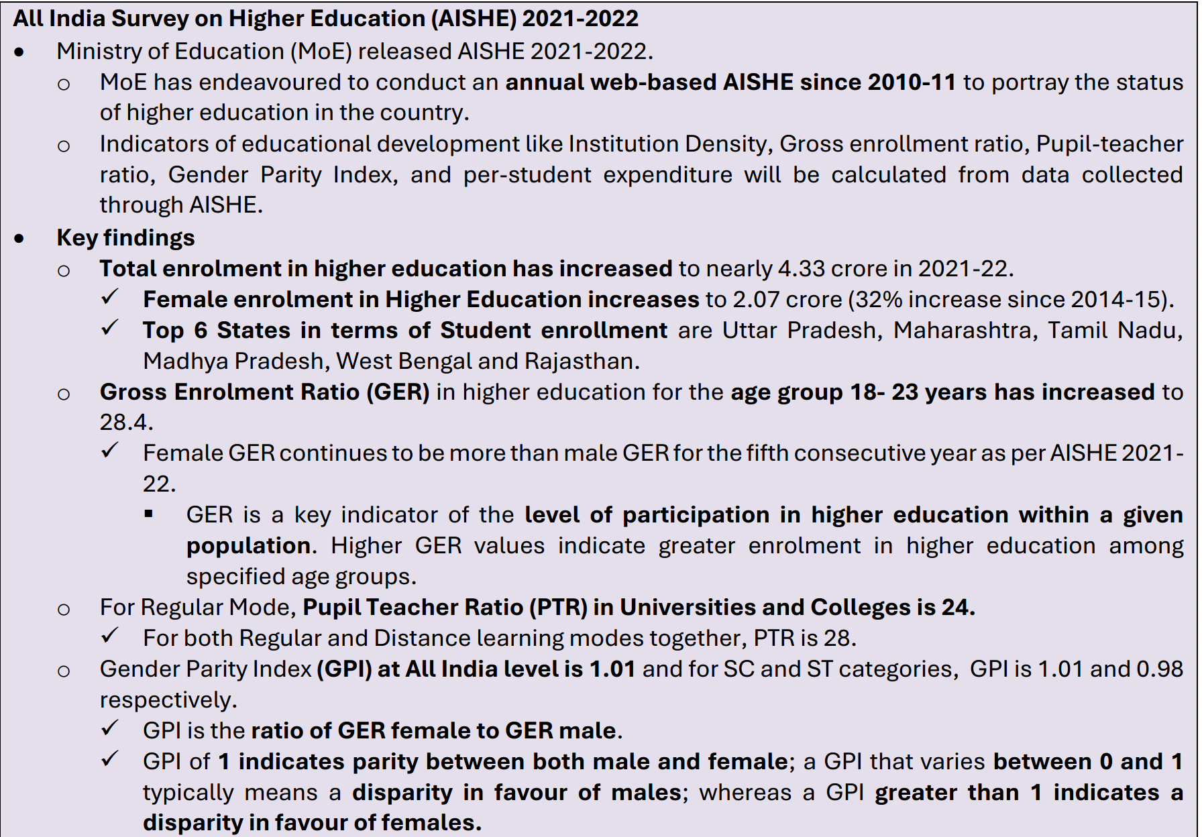

Slide 23
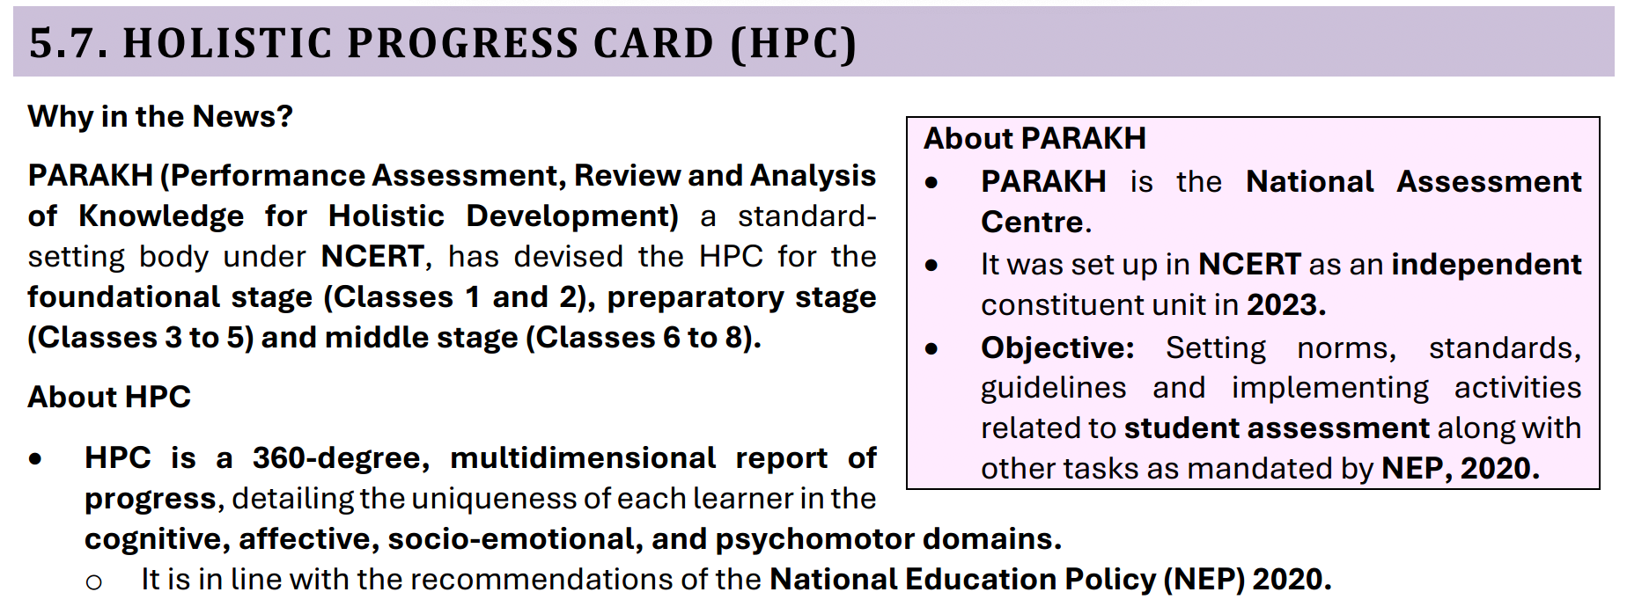

Slide 24
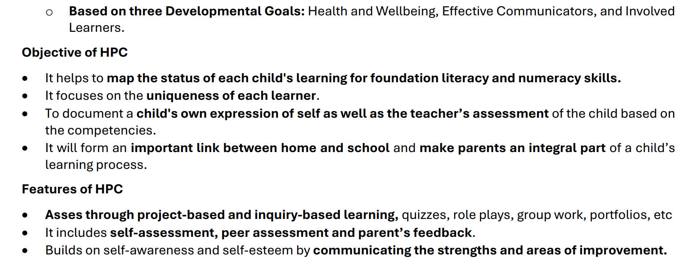

Slide 25
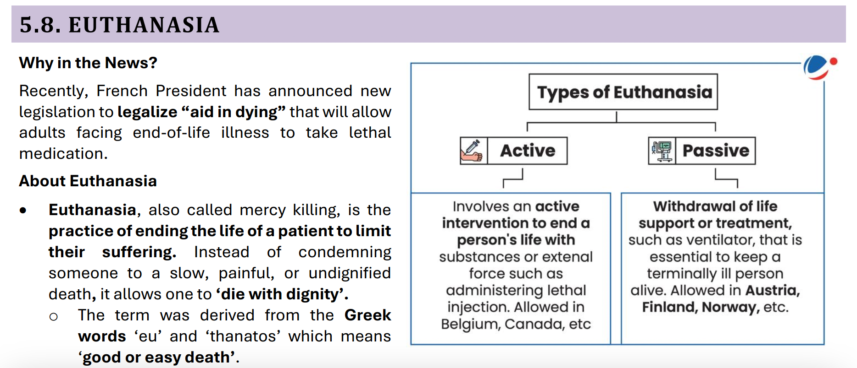

Slide 26
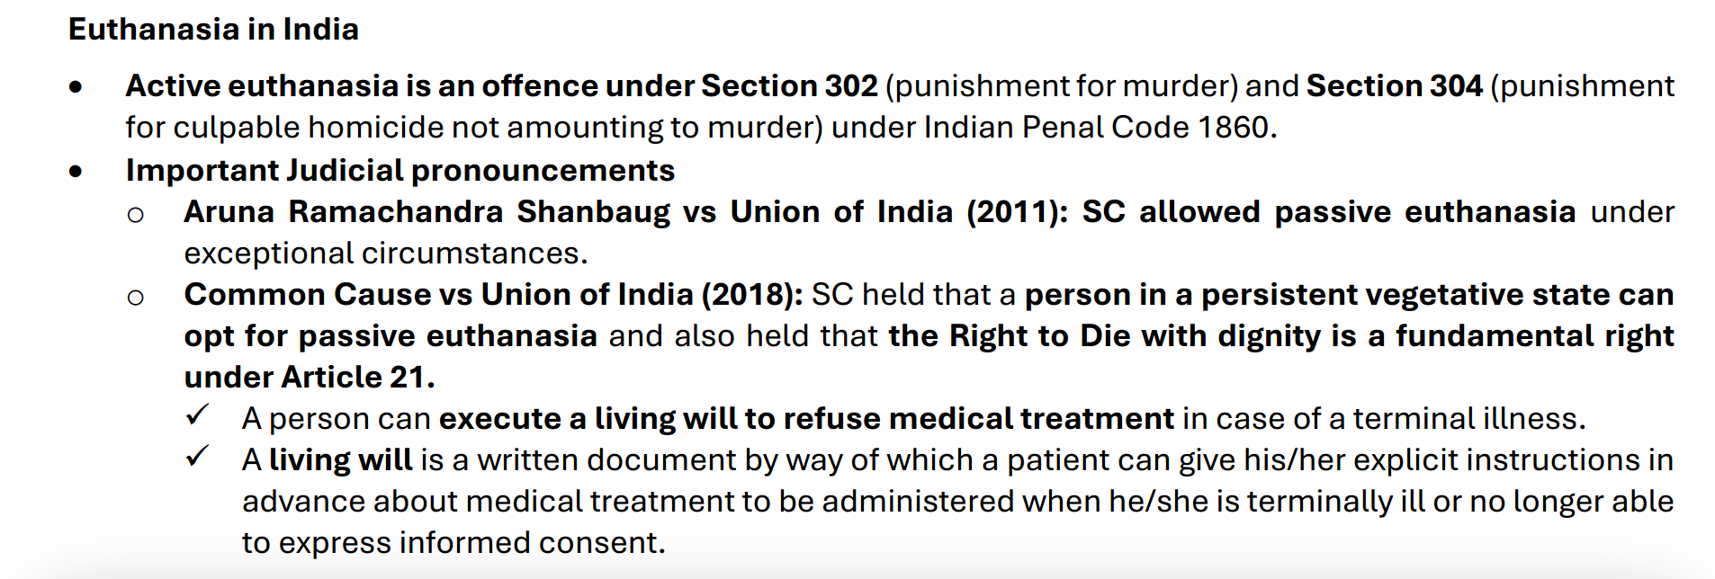

Slide 27
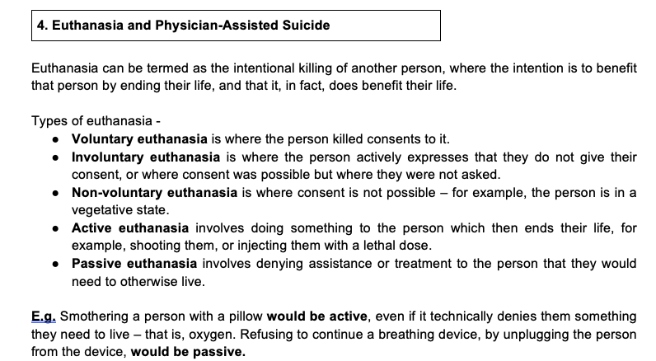

Slide 28
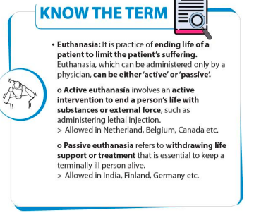

Slide 29
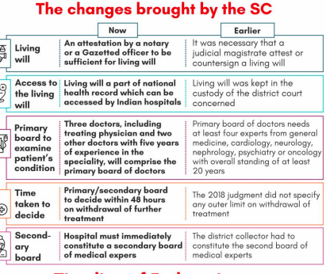

Slide 30

What is the concept of living will?
It refers to a written document that a person uses to give his explicit instructions in advance about the medical treatment to be administered if he becomes incompetent or is unable to communicate. In many countries, the concept of Living Wills has been widely encouraged

Slide 31
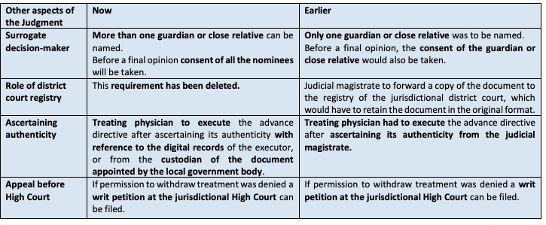

Slide 32
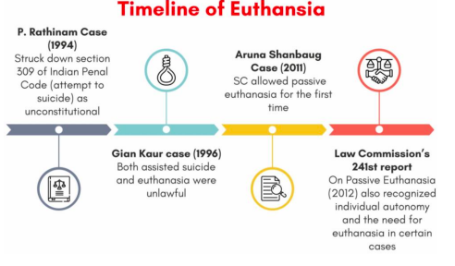

Slide 33
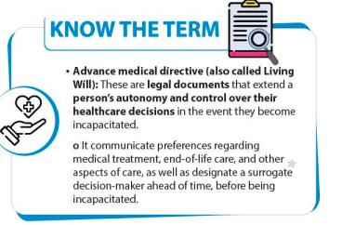

Slide 34
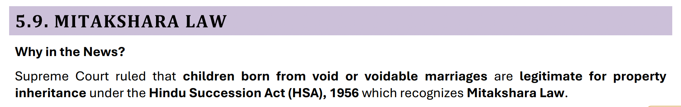

Slide 35
Voidable Marriage: A voidable marriage is a marriage that is initially valid but has certain defects or conditions that
can lead to its annulment if one of the parties chooses to do so.
Void Marriage: A void marriage is one that is considered invalid from the very beginning as if it never existed in the
eyes of the law

Slide 36
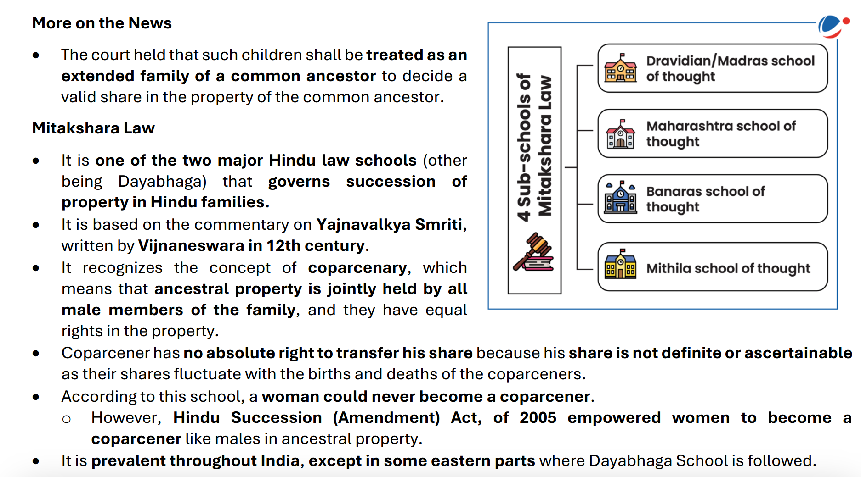

Slide 37
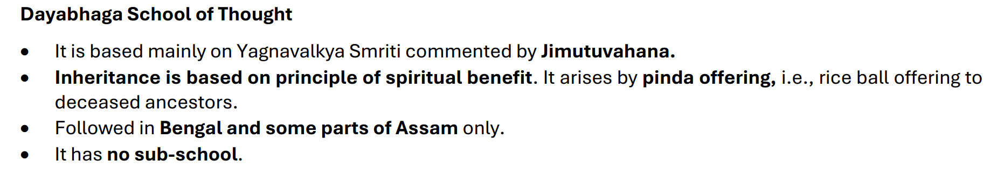

Slide 38
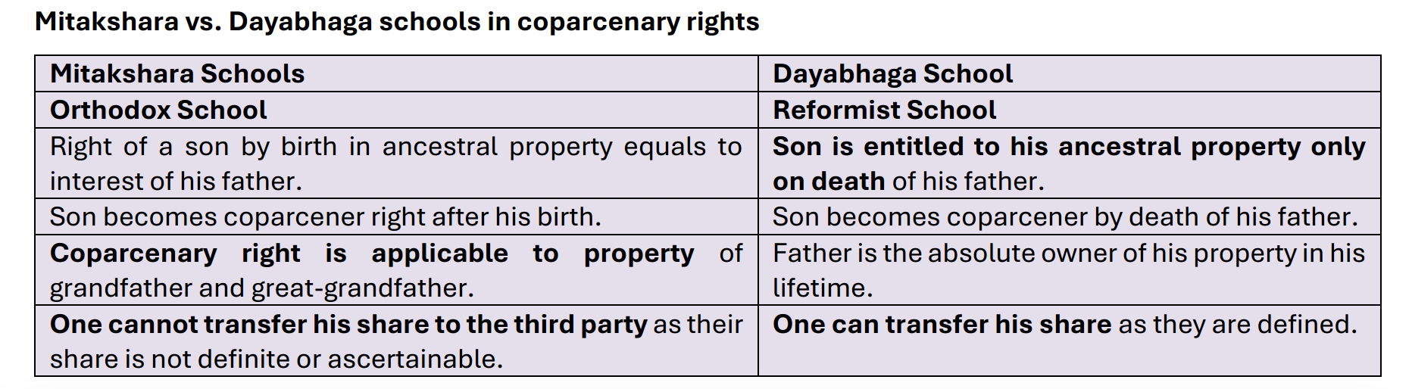

Slide 39
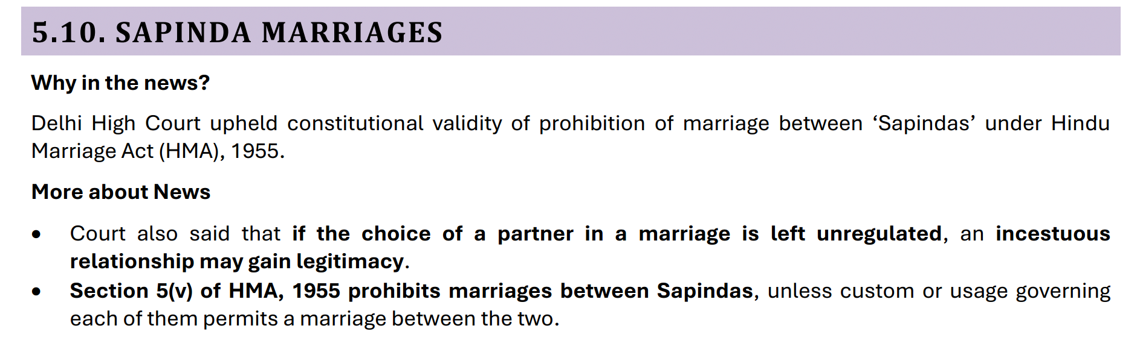

Slide 40
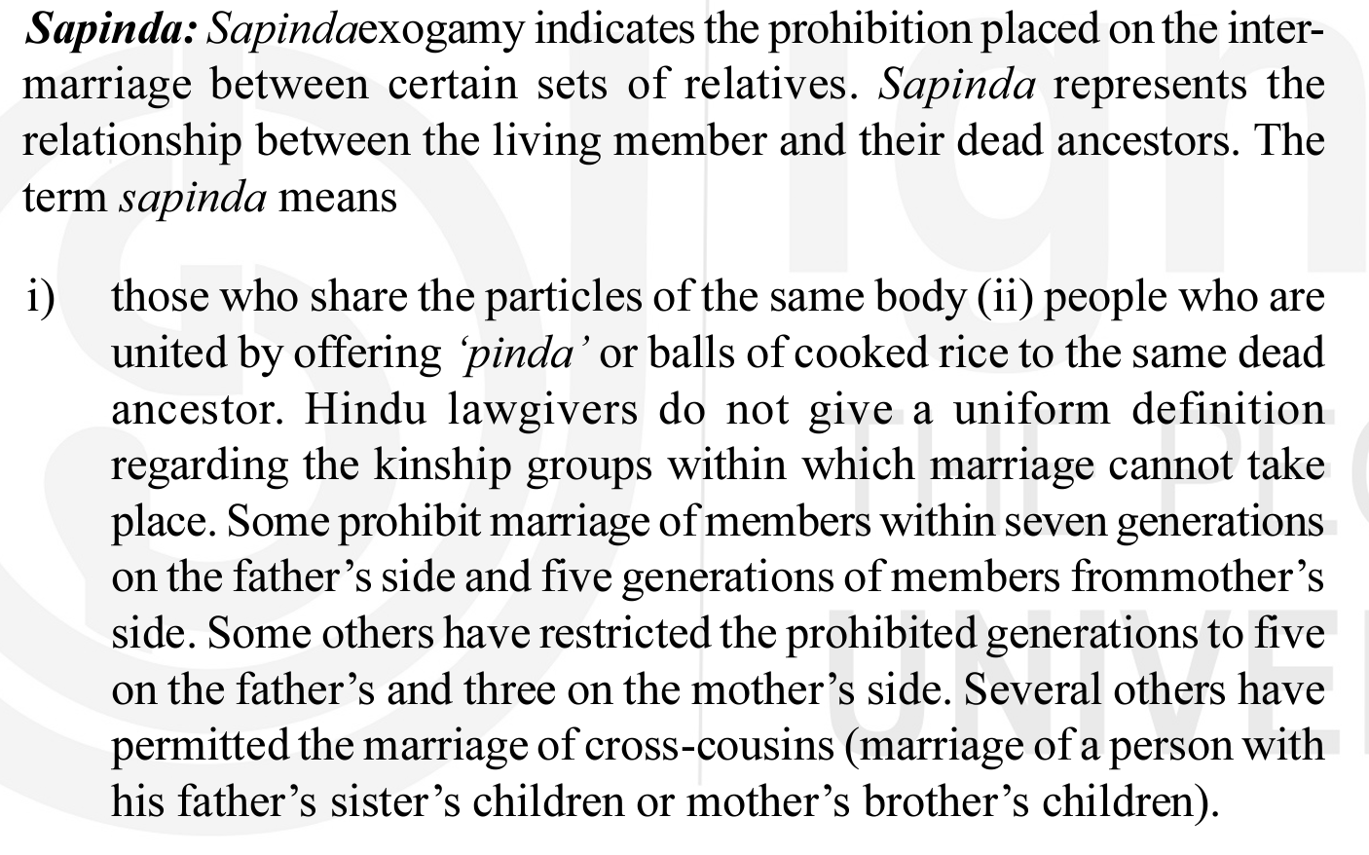

Slide 41
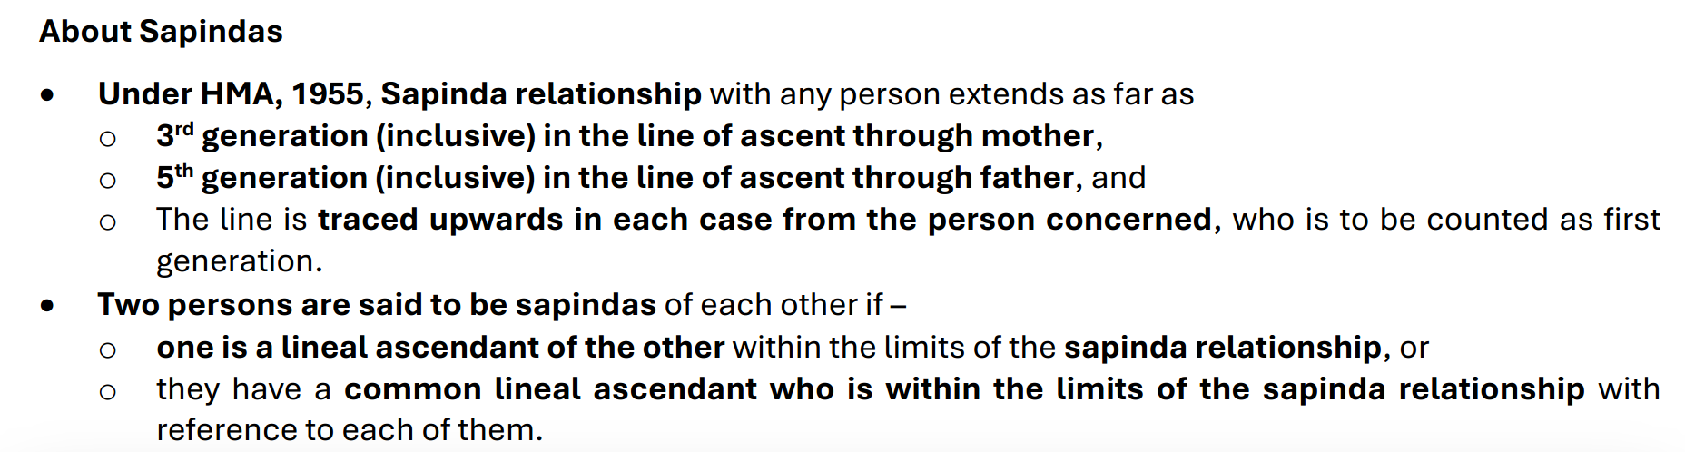

Slide 42
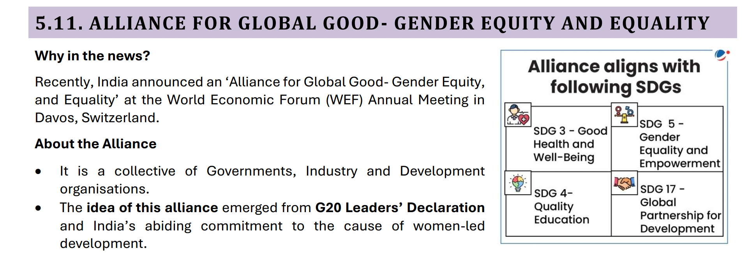

Slide 43
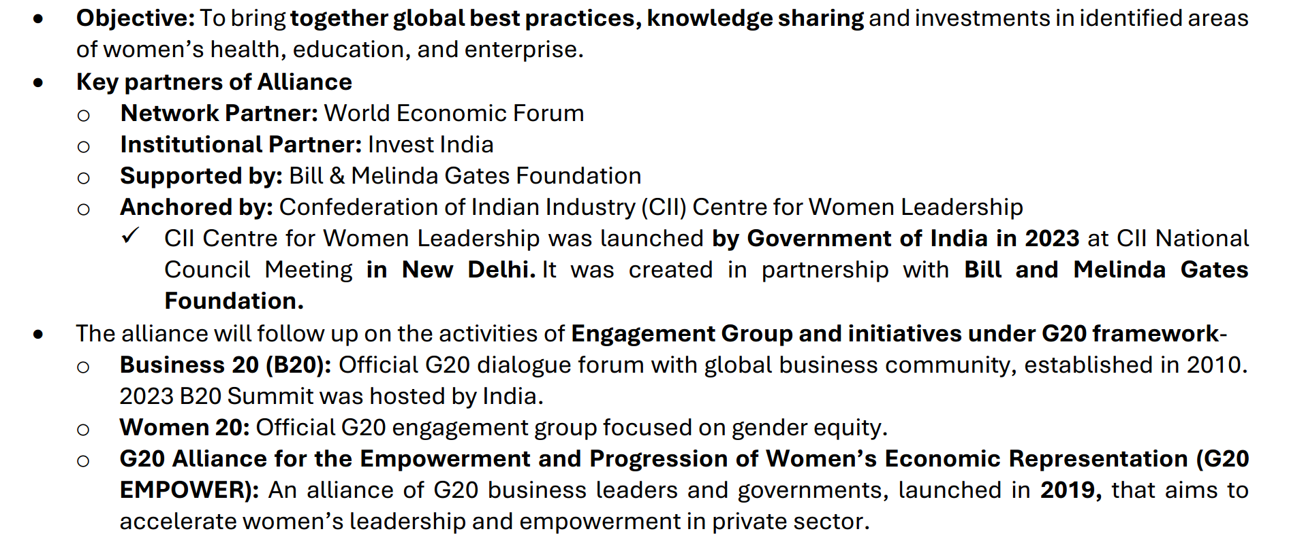

Slide 44
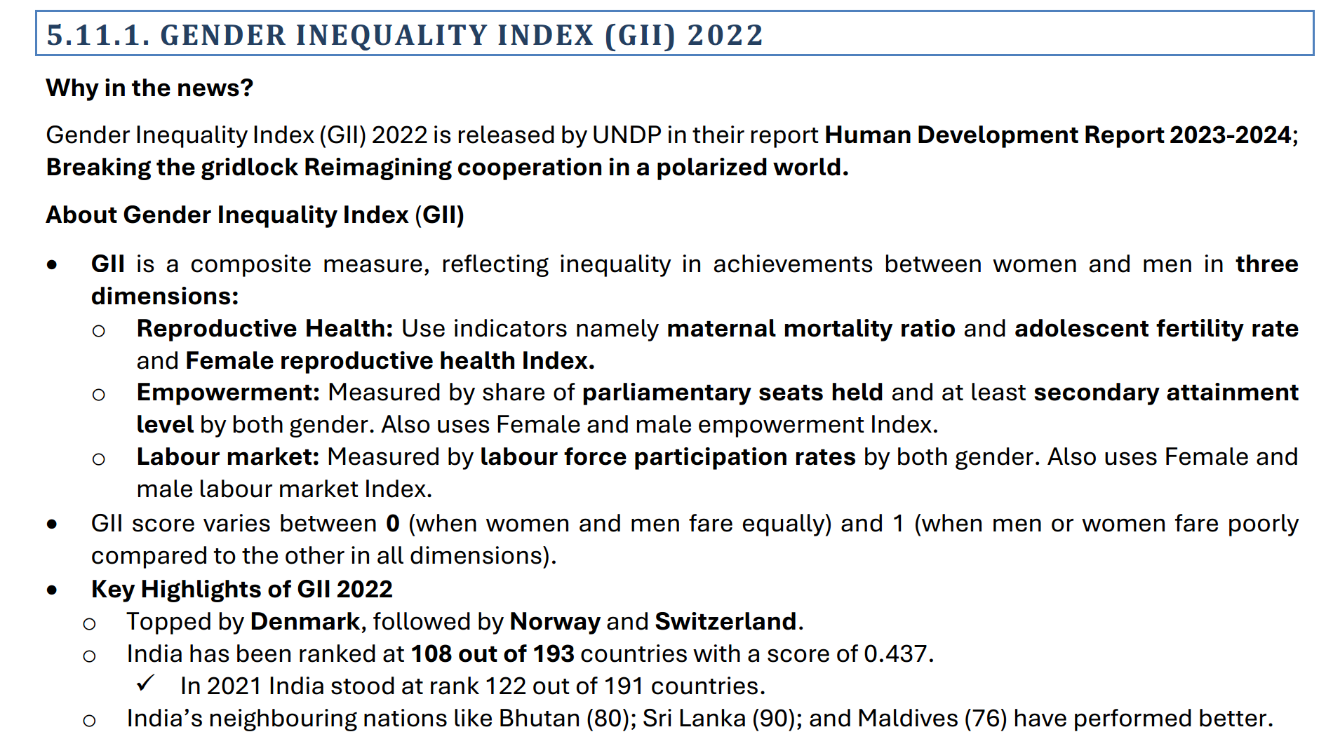

Slide 45
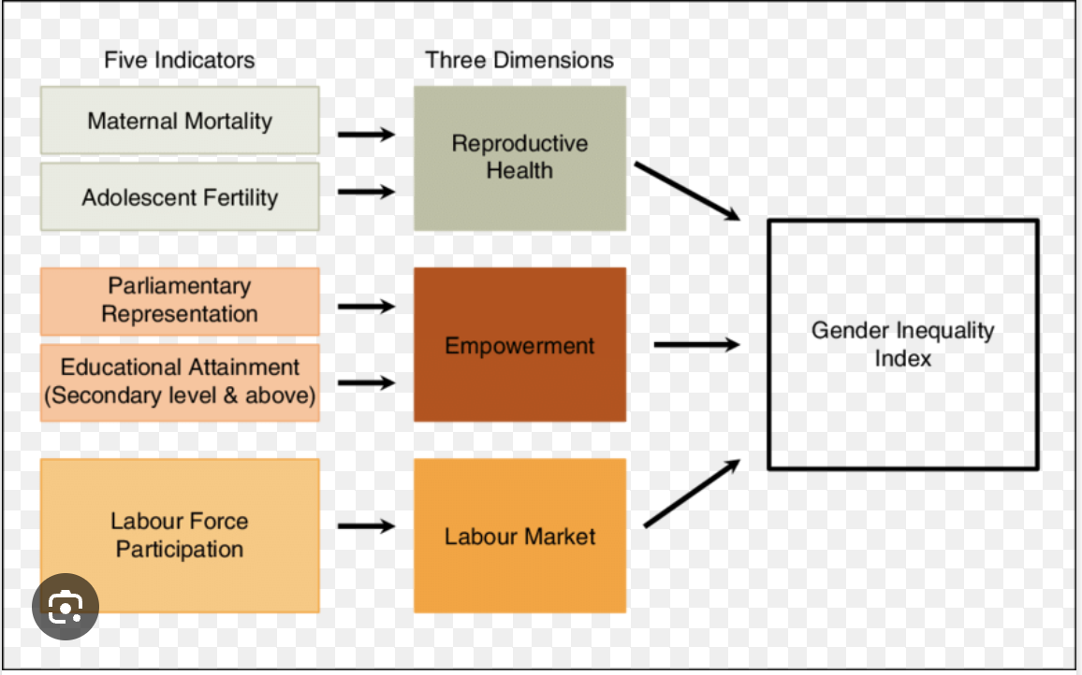

Slide 46
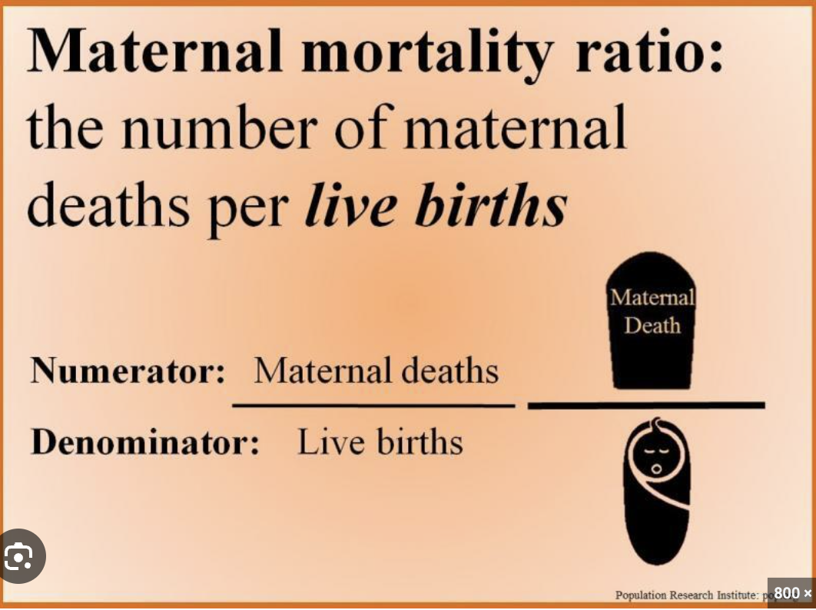

Slide 47
Adolescent fertility rate is the number of births per 1,000 women ages 15-19

Slide 48
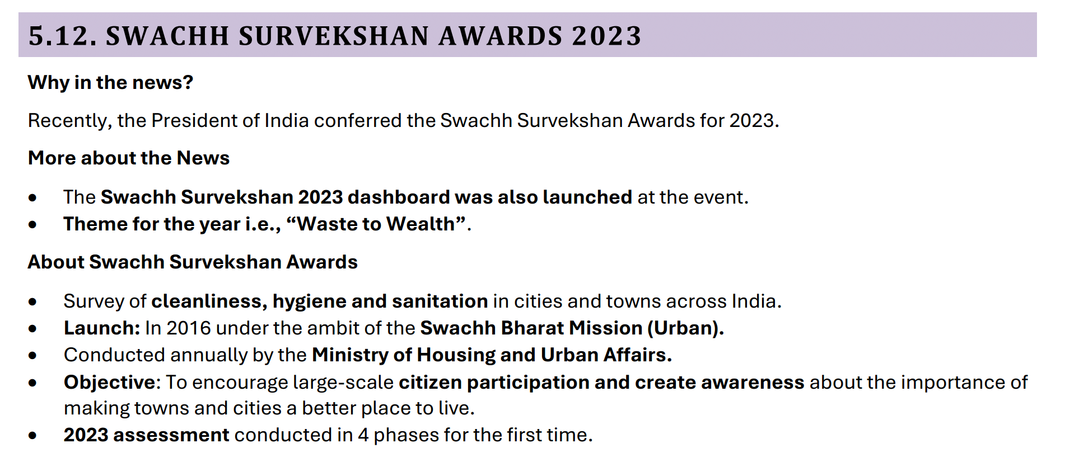

Slide 49
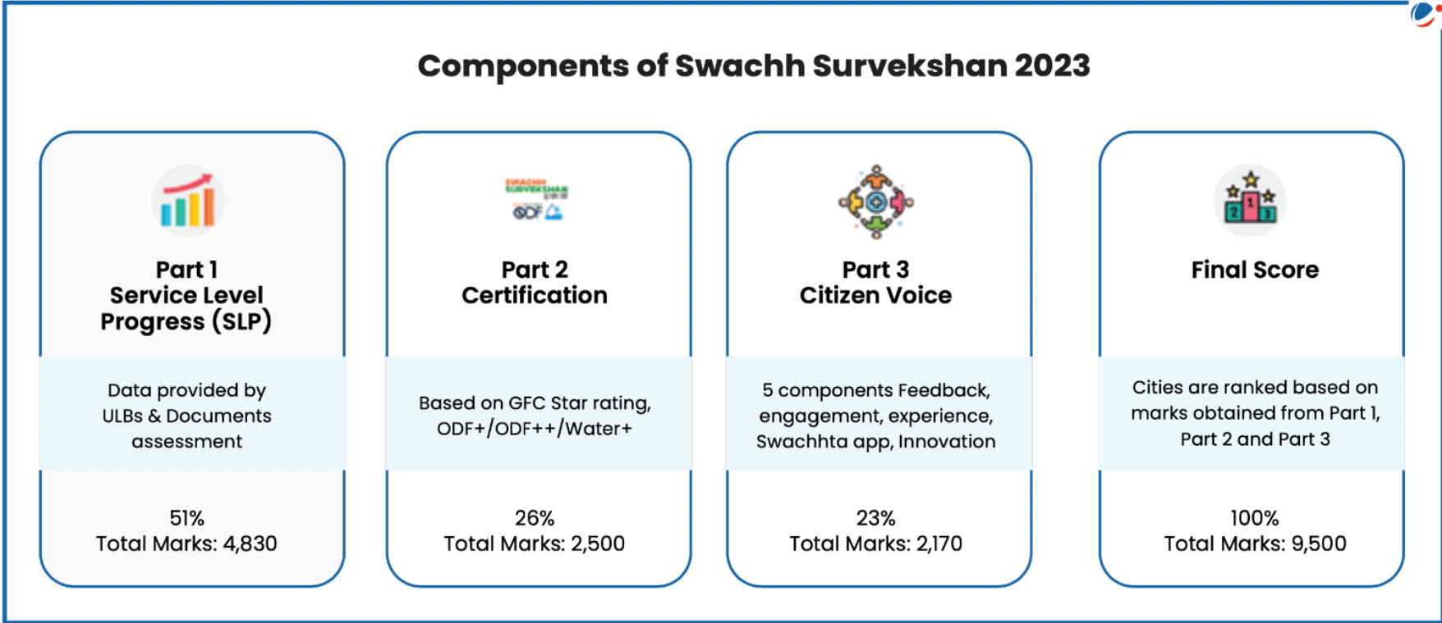

Slide 50
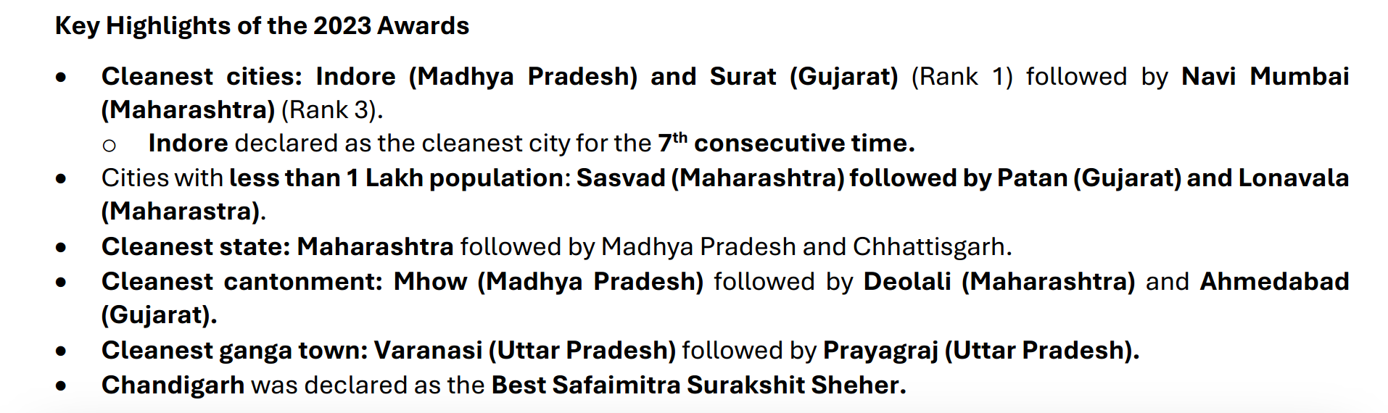

Slide 51
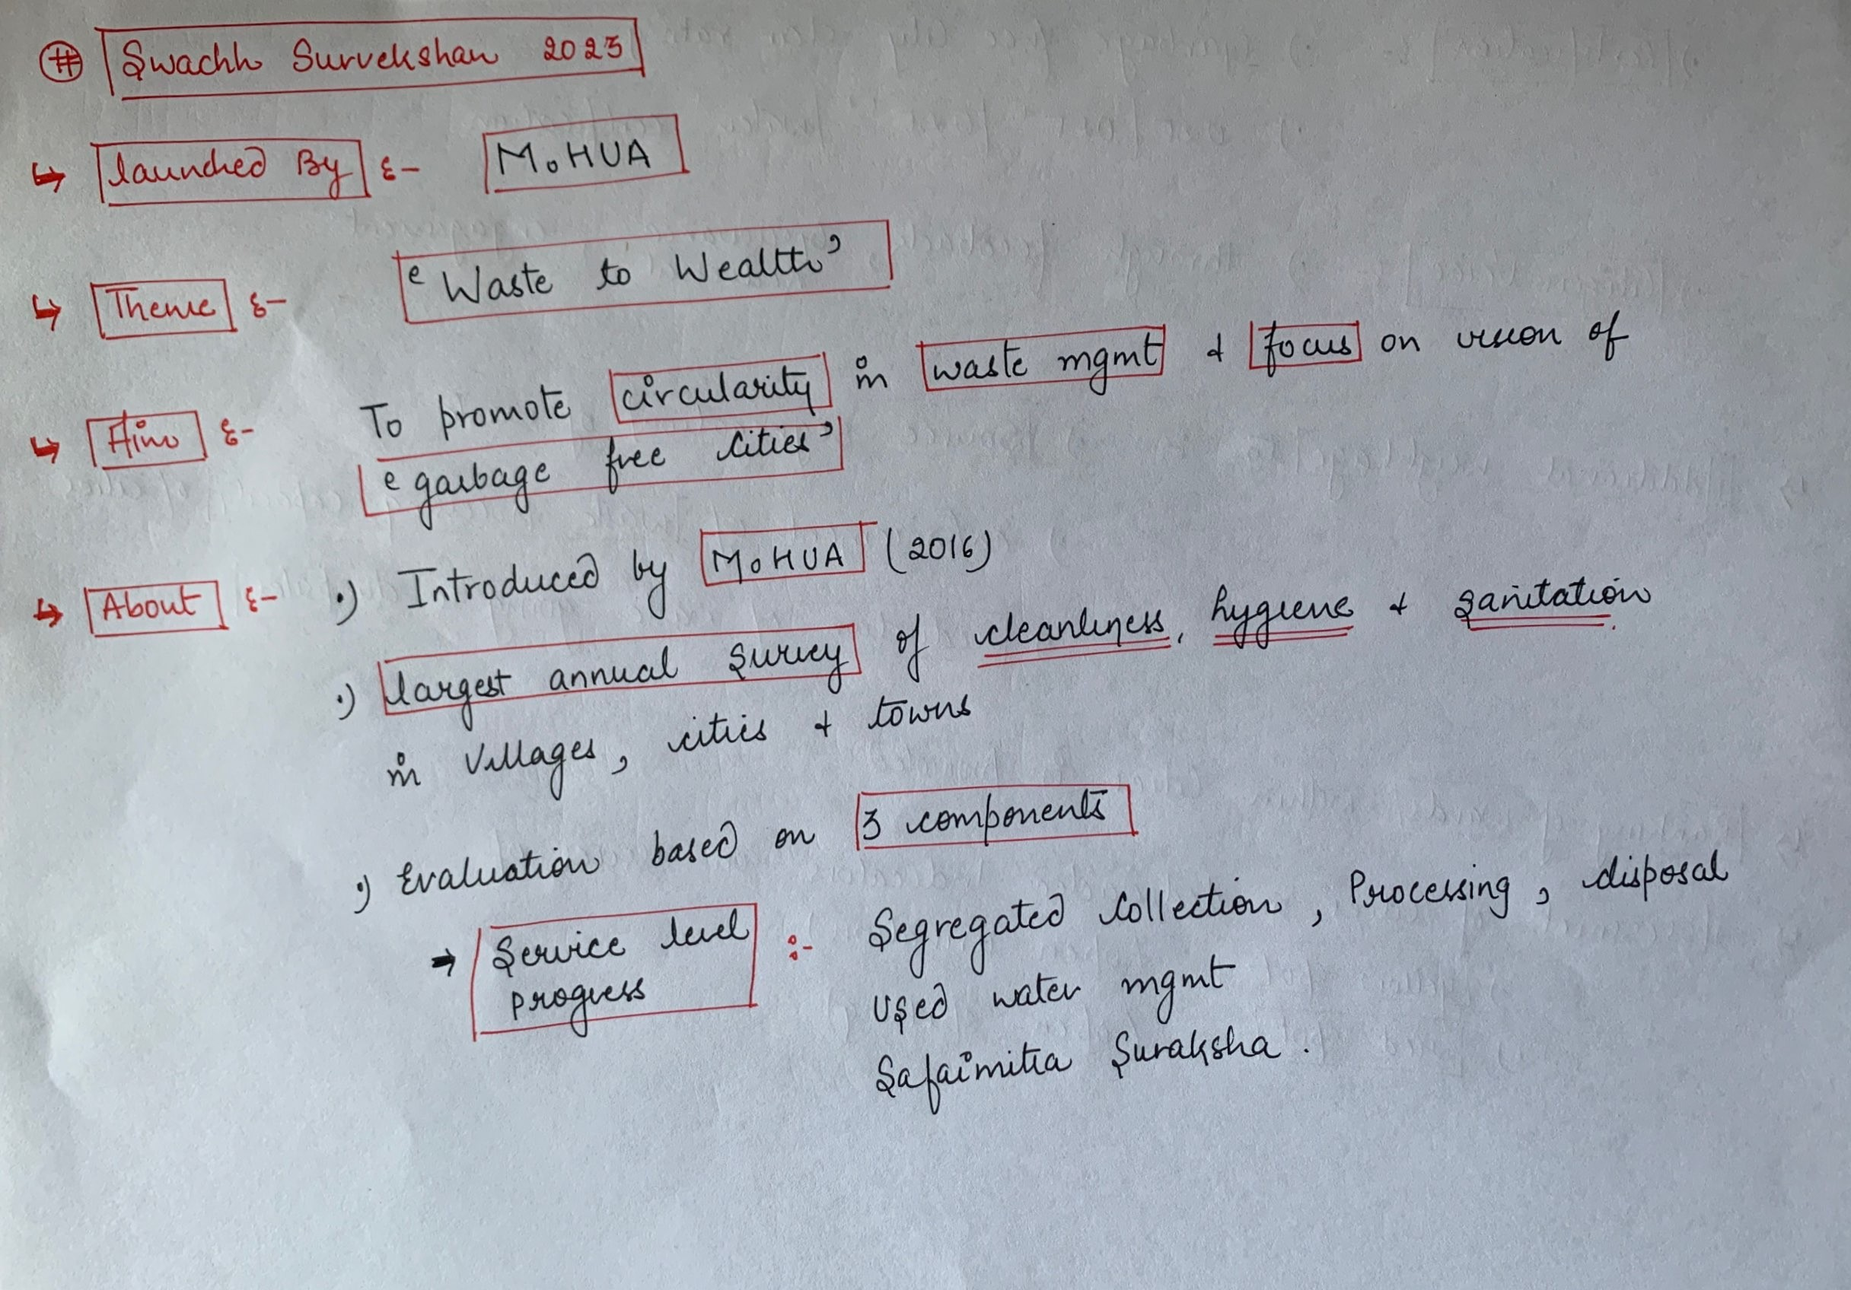

Slide 52
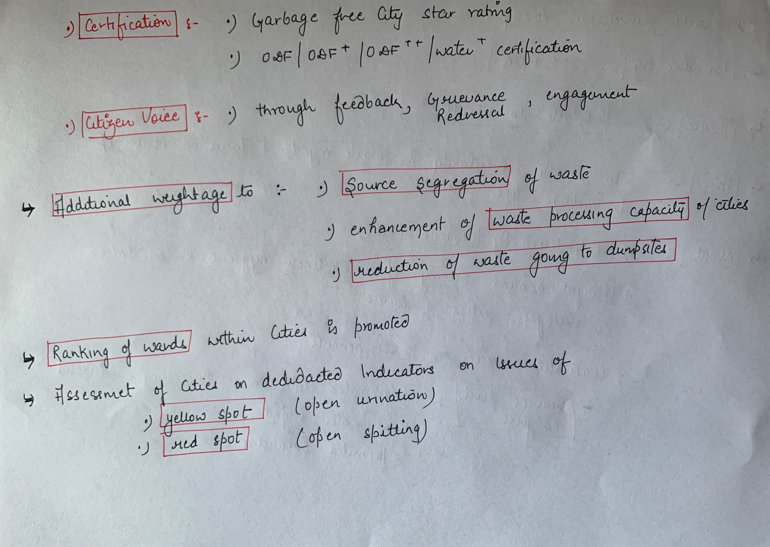

Slide 53
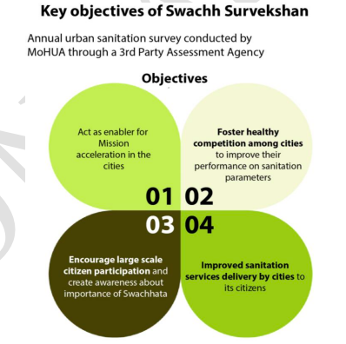

Slide 54
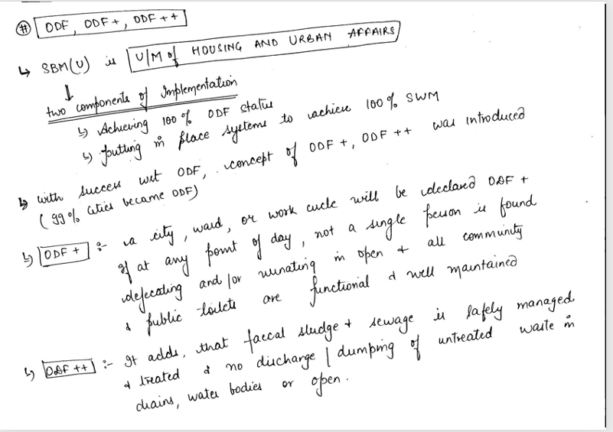

Slide 55
A city / ward / circle / zone can be declared as Water Plus provided all wastewater released from households, commercial establishments ,drains, nallahs etc. is treated to a satisfactory level (as per CPCB norms), before releasing the treated wastewater to the environment

Slide 56
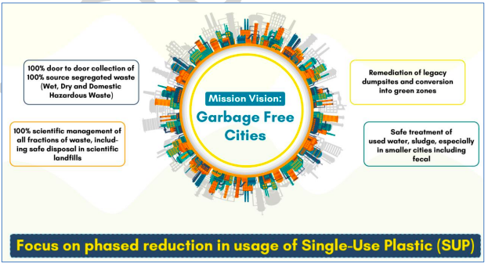

Slide 57


Slide 58


Slide 59


Slide 60


Slide 61


Slide 62


Slide 63


Slide 64


Slide 65


Slide 66


Slide 67


Slide 68


Slide 69
Mission LiFE stands for "LiFEStyle For Environment.”
It is a campaign initiated by the Central Pollution Control Board (CPCB) in India.
The objective of Mission LiFE is to promote and encourage a sustainable and environmentally conscious way of living.

Slide 70


Slide 71


Slide 72
The World Happiness Report is published annually by the United Nations Sustainable Development Solutions Network and
takes into account six variables — GDP per capita, healthy life expectancy, having someone to count on, freedom to make life choices, generosity, and freedom from corruption.
It is supported by taking the average life evaluation data gathered by the Gallup polls for the 2021-23 period.

Slide 73
The report observed that in India, older age is associated with higher life satisfaction.
However, older Indian women reported lower life satisfaction than older men, it added.
Education and caste played key roles, with older adults with secondary or higher education and those of higher social castes reporting higher life satisfaction than their counterparts without formal education and those from scheduled castes and scheduled tribes, it said.
Worldwide, women were less happy than men in every region, with the gender gap widening as they aged, said the report.

Slide 74


Slide 75


Slide 76
About SWATI Portal
Purpose: The portal serves as a single online platform to represent and showcase the contributions of Indian women and girls in STEMM fields.
Database: It houses a comprehensive database that will aid policymakers in addressing the challenges of gender gap in STEMM fields.
Interactive Features: SWATI Portal is designed to be interactive, allowing users to access and contribute to the database easily
Development: The portal is the first-of-its-kind in India and has been developed, hosted, and maintained by the National Institute of Plant Genome Research (NIPGR) located in New Delhi.

Slide 77


